Slide 1
Python
File Input Output
Session 10

Slide 2
Objectives
File Input Output
Directory in Python
Read Write File in Python

Slide 3
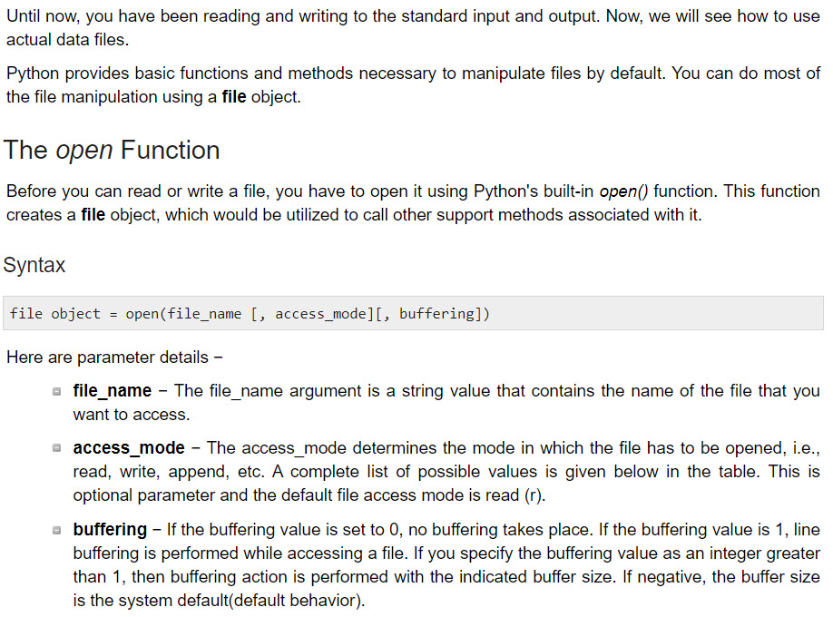
Opening and Closing Files

Slide 4
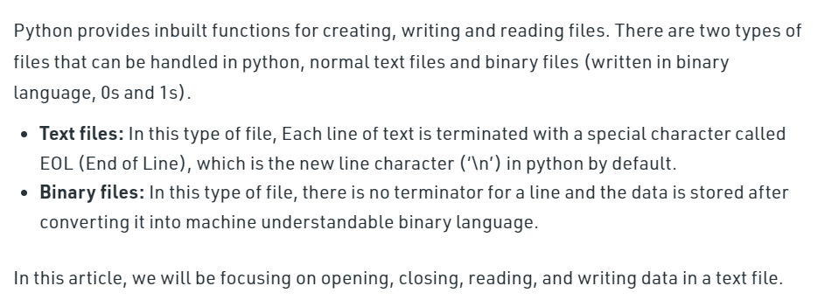
Reading/Writing to text files in Python

Slide 5
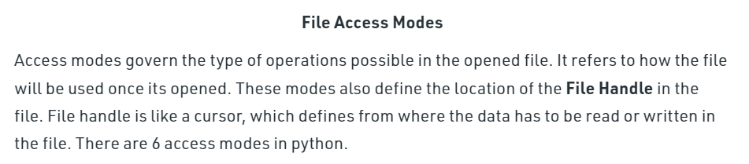
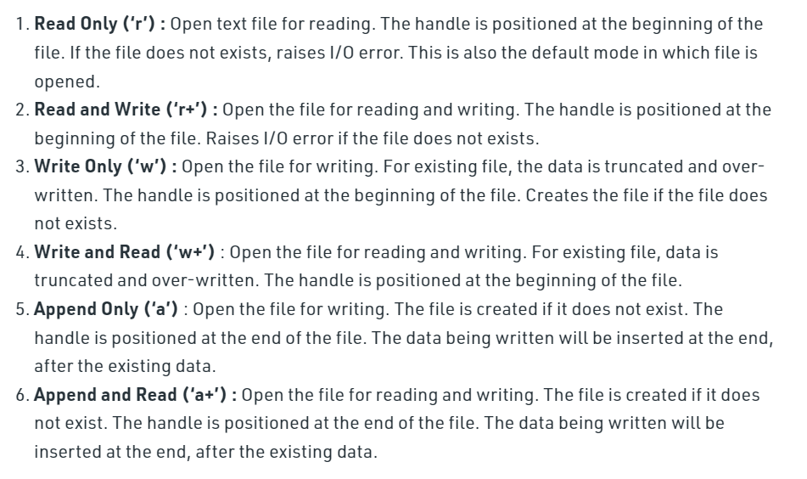
Reading/Writing to text files in Python

Slide 6
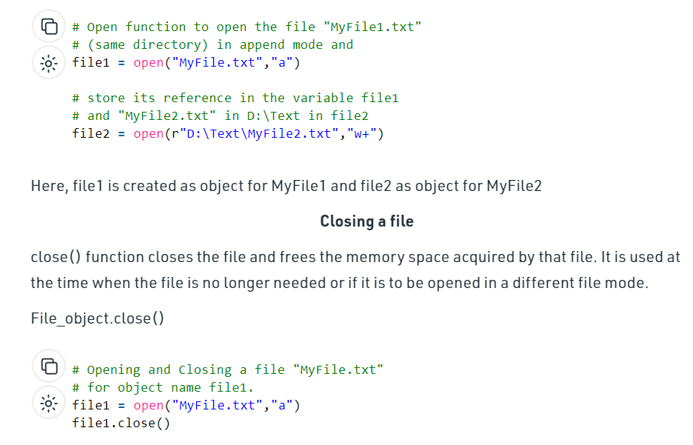
Reading/Writing to text files in Python

Slide 7
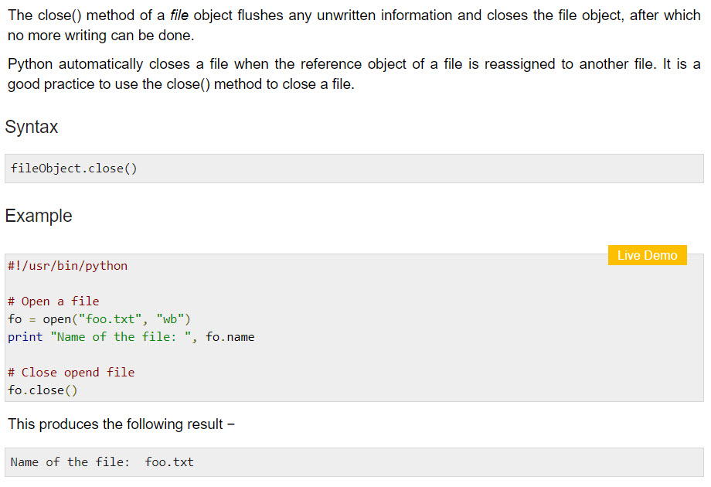
The close() Method

Slide 8
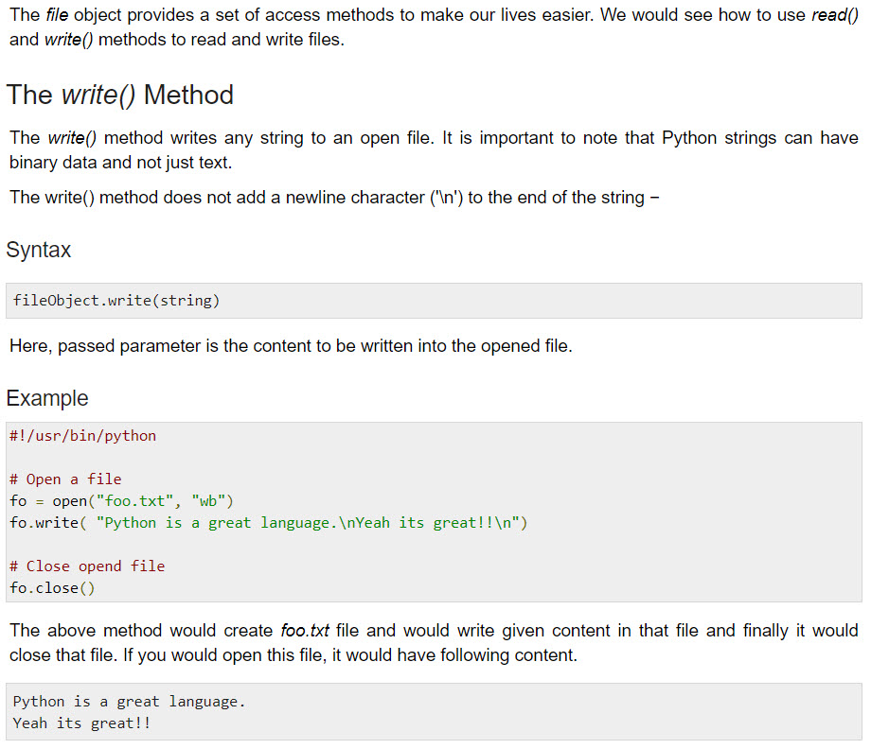
Reading and Writing Files

Slide 9
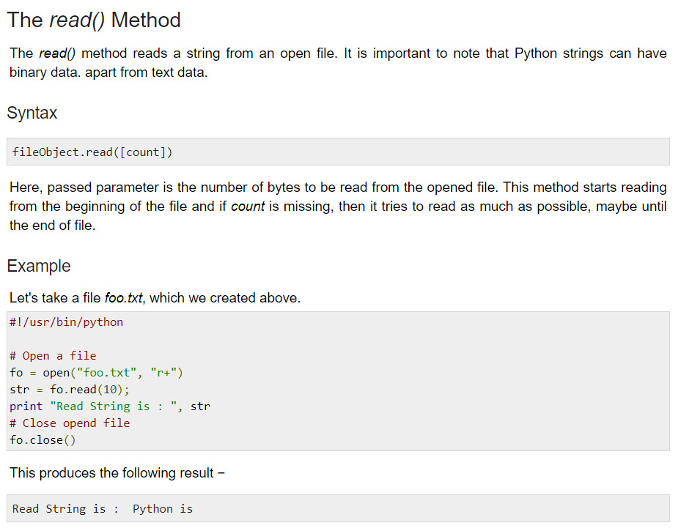
Reading and Writing Files

Slide 10
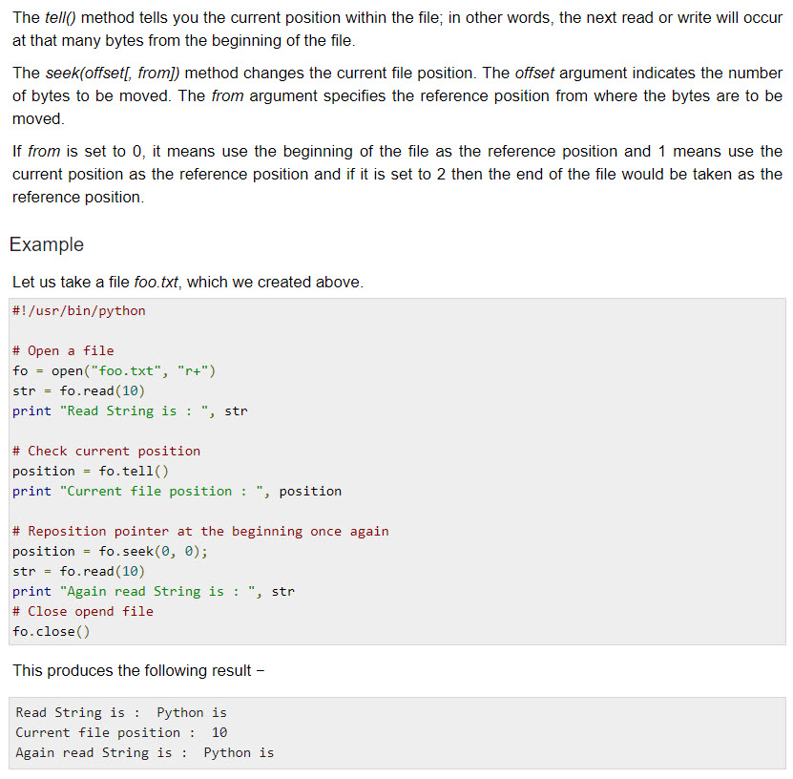
File Positions

Slide 11
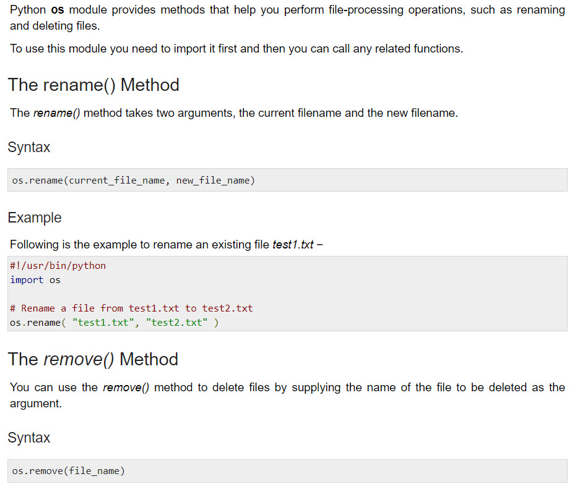
Renaming and Deleting Files

Slide 12
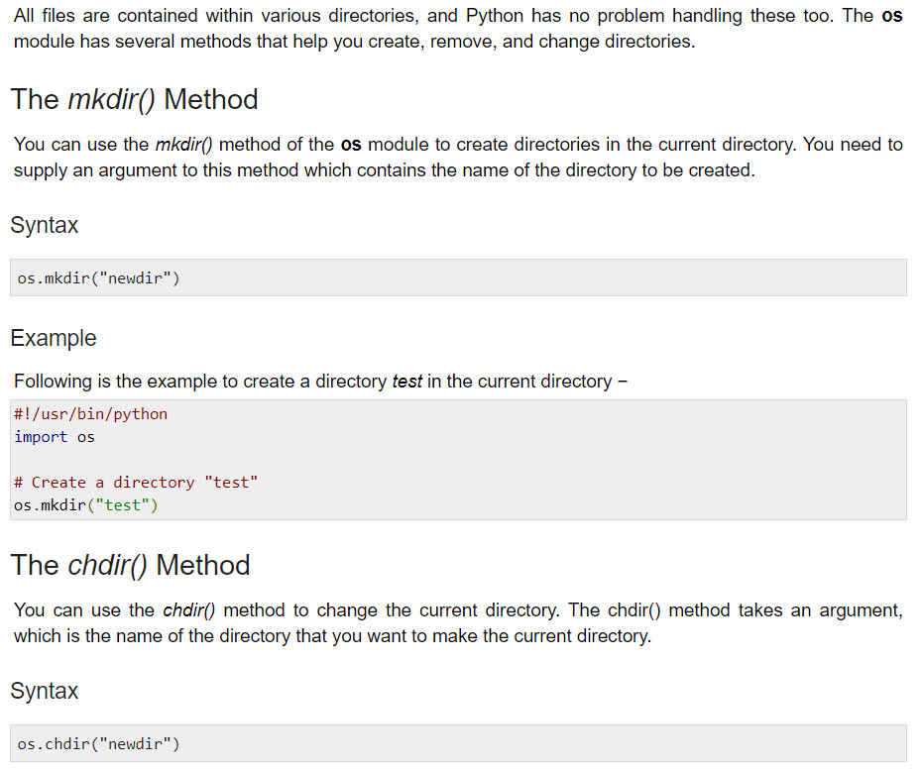
Directories in Python

Slide 13

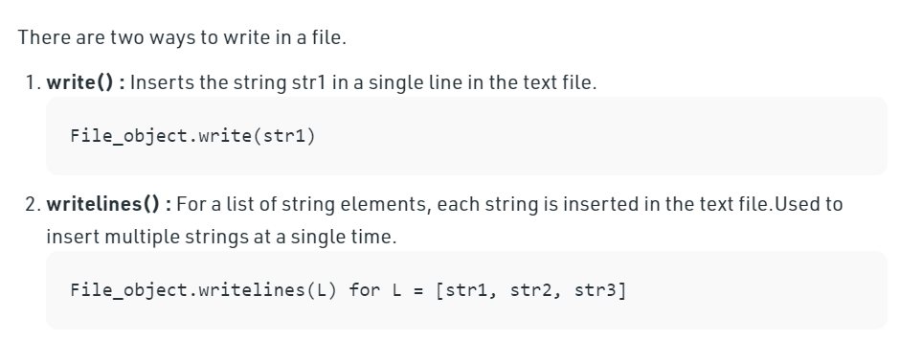
Reading/Writing to text files in Python

Slide 14
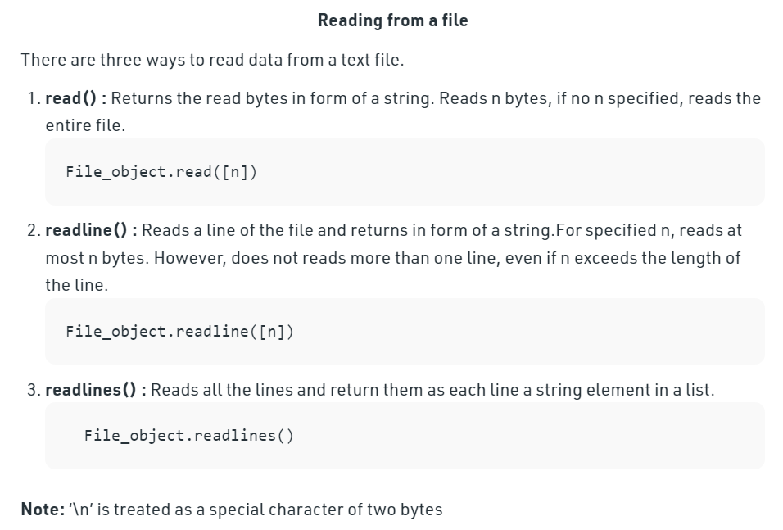
Reading/Writing to text files in Python

Slide 15
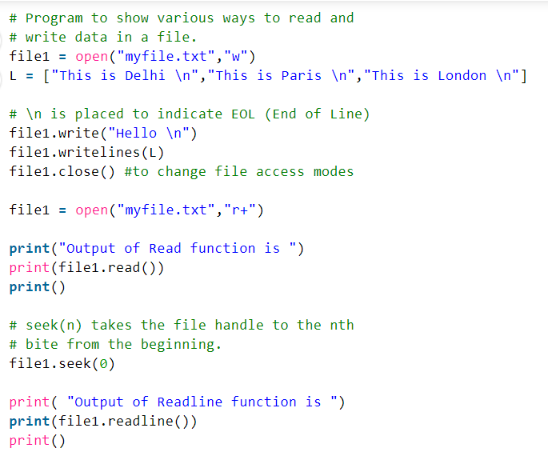
Reading/Writing to text files in Python

Slide 16
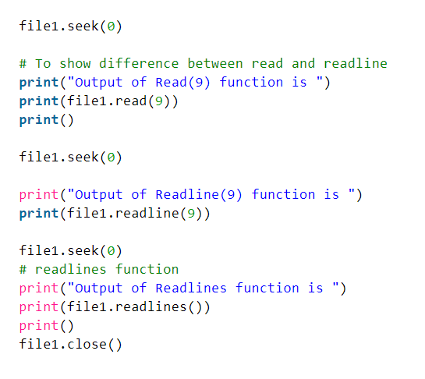
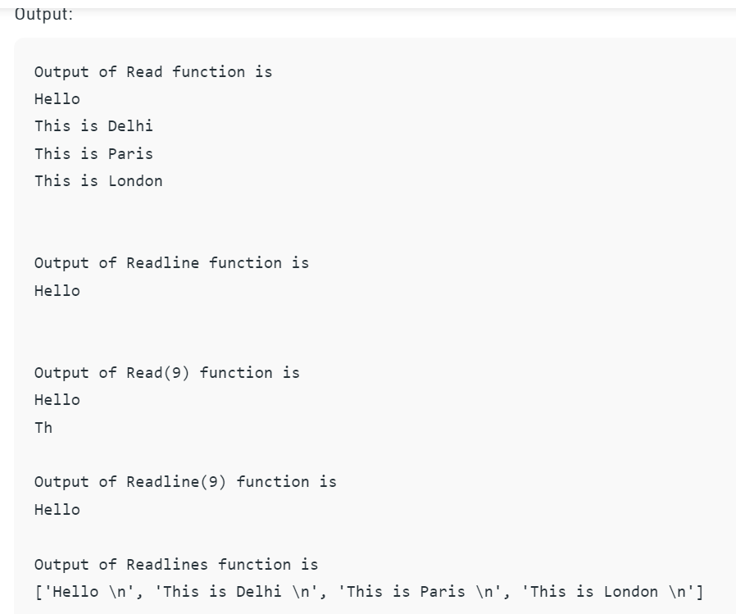
Reading/Writing to text files in Python

Slide 17
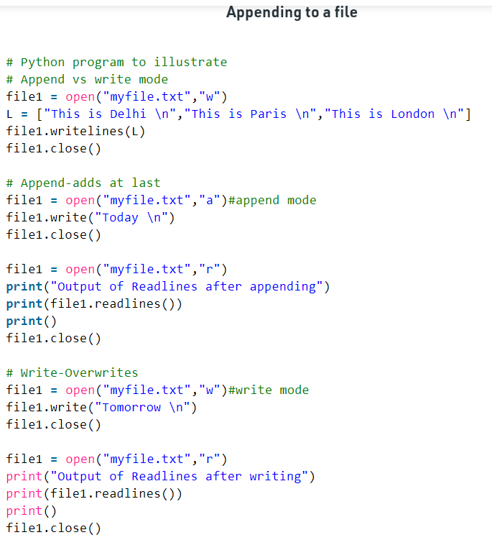
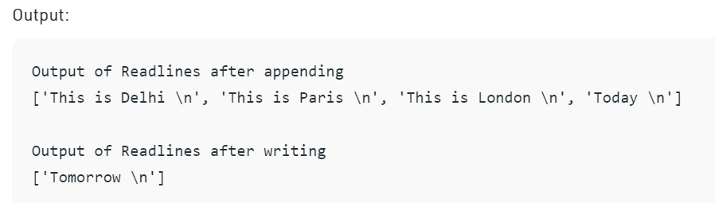
Reading/Writing to text files in Python

Slide 18
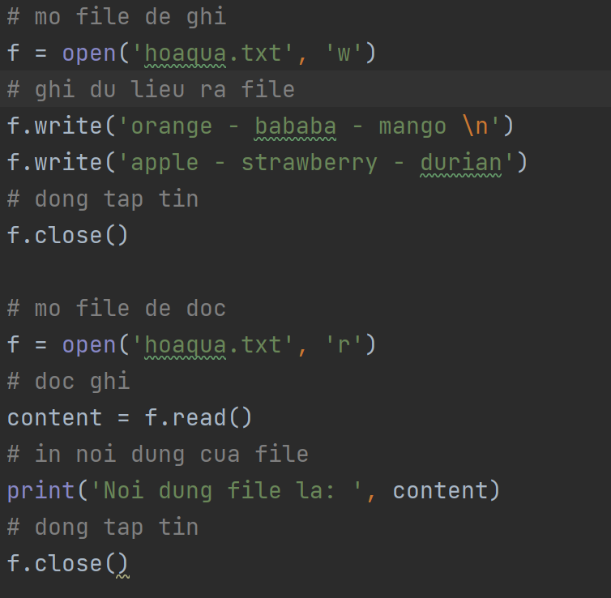
Reading/Writing to text files in Python

Slide 19
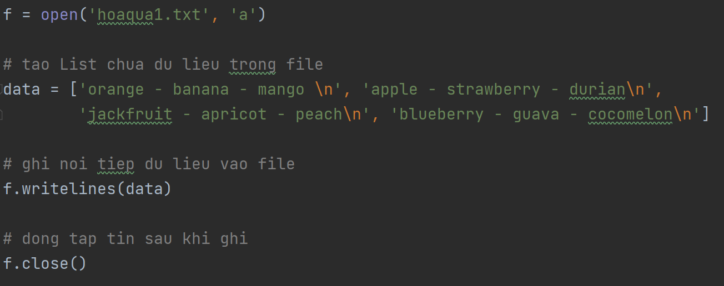
Reading/Writing to text files in Python

Slide 20
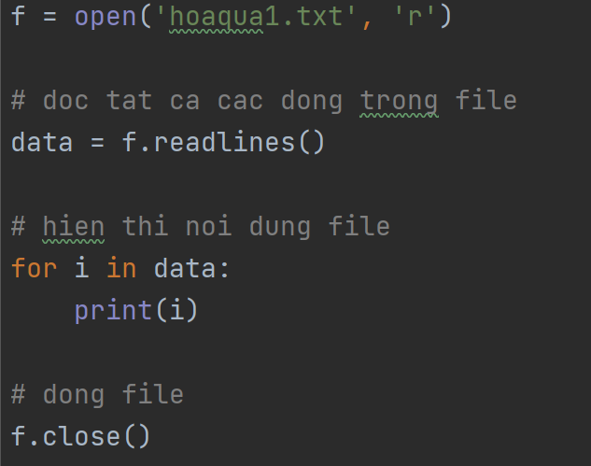
Reading/Writing to text files in Python

Slide 21
Summary
File Input Output
Directory in Python
Read Write File in Python

